Slide 1
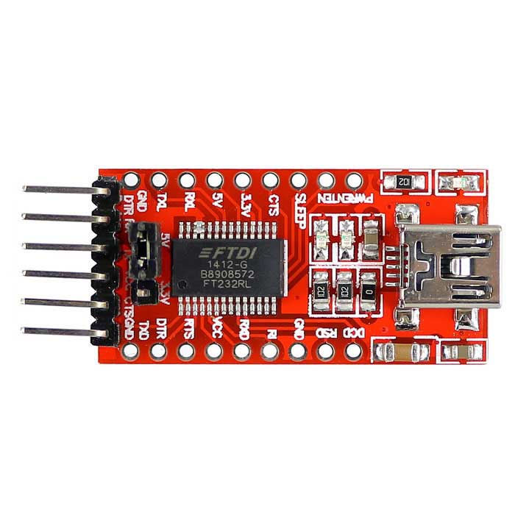
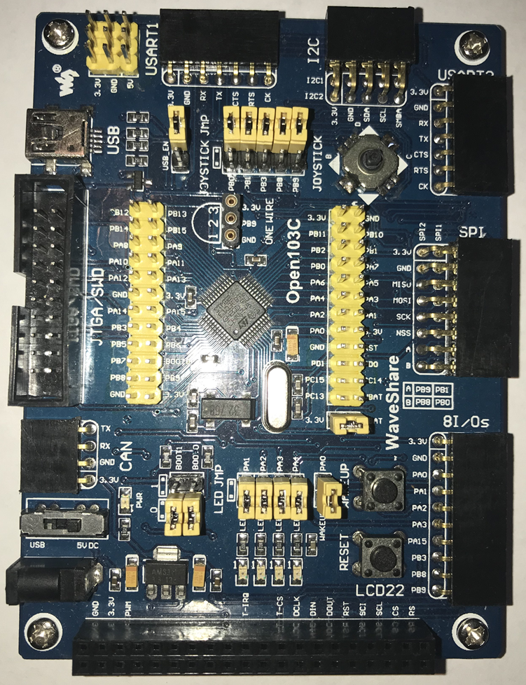
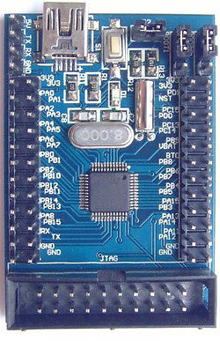
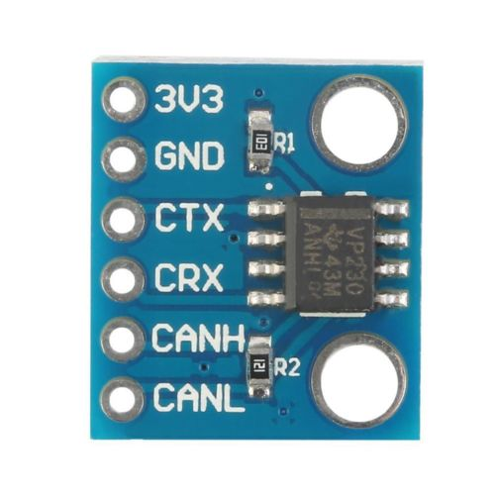
FT232RL USB to USART
+5V Power
SLCAN Adapter
uc4h-slcan-v007-pcb-v1x-f103t8c8cb.hex
PB6 = A1
PB7 = A2
PB0 = B1
PB1 = B2
PA0 = C1
PA1 = C2
GND
GND
CTS
VCC
TX
RX
DTR
ESC/ACT Node
uc4h-bootloader-v002.hex
uc4h-escactuator-v014-node-v1x-f103t8c8cb-wobl.hex
<- RX USB-TTL
CANH
TX USB-TTL ->
CANL
CANRX
CANTX
GND
+3.3V Power
PA11 (GRN) = CANRX
PA12 (YEL) = CANTX
PA9 (BRN) = UART1_TX -> RX USB-TTL
PA10 (GRY) = UART1_RX -> TX USB-TTL

Slide 2
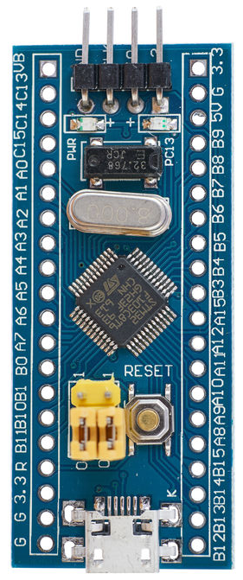
PB6 = A1
PB7 = A2
PB0 = B1
PB1 = B2
PA0 = C1
PA1 = C2
FT232RL USB to USART
+5V Power
SLCAN Adapter
uc4h-slcan-v007-pcb-v1x-f103t8c8cb.hex
GND
GND
CTS
VCC
TX
RX
DTR
<- RX USB-TTL
CANH
TX USB-TTL ->
CANL
CANRX
CANTX
GND
+3.3V Power
PA11 (GRN) = CANRX
PA12 (YEL) = CANTX
PA9 (BRN) = UART1_TX -> RX USB-TTL
PA10 (GRY) = UART1_RX -> TX USB-TTL
ESC/ACT Node
uc4h-bootloader-v002.hex
uc4h-escactuator-v014-node-v1x-f103t8c8cb-wobl.hex

Slide 3
PB6 = A1
PB7 = A2
PB0 = B1
PB1 = B2
PA0 = C1
PA1 = C2
FT232RL USB to USART
+5V Power
SLCAN Adapter
uc4h-slcan-v007-pcb-v1x-f103t8c8cb.hex
GND
GND
CTS
VCC
TX
RX
DTR
<- RX USB-TTL
CANH
TX USB-TTL ->
CANL
CANRX
CANTX
GND
+3.3V Power
PA11 (GRN) = CANRX
PA12 (YEL) = CANTX
PA9 (BRN) = UART1_TX -> RX USB-TTL
PA10 (GRY) = UART1_RX -> TX USB-TTL
ESC/ACT Node
uc4h-bootloader-v002.hex
uc4h-escactuator-v014-node-v1x-f103t8c8cb-wobl.hex

Slide 4
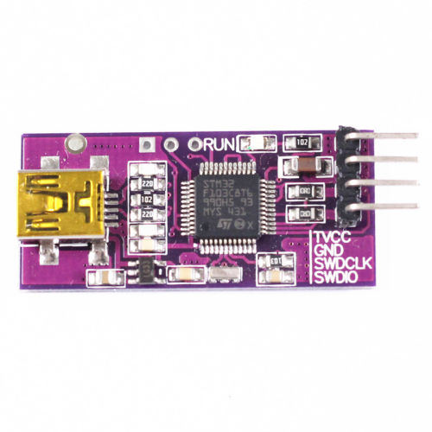
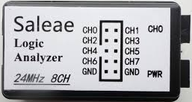
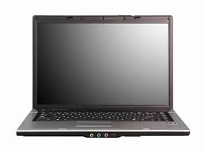
PB6 = A1
PB7 = A2
PB0 = B1
PB1 = B2
PA0 = C1
PA1 = C2
ARM SWD DEBUGGER
FT232RL USB to USART
+5V Power
GND
GND
CTS
SWDIO
VCC
SLCAN Adapter
uc4h-slcan-v007-pcb-v1x-f103t8c8cb.hex
SWCLK
TX
GND
RX
Vcc
DTR
<--
-->
PA11 (GRN) = CANRX
PA12 (YEL) = CANTX
PA9 (BRN) = UART1_TX -> RX USB-TTL
PA10 (GRY) = UART1_RX <- TX USB-TTL
CANH
CANL
REMOVE
CANRX
CANTX
GND
+3.3V Power
CANRX
USB
ESC/ACT Node
uc4h-bootloader-v002.hex
uc4h-escactuator-v014-node-v1x-f103t8c8cb-wobl.hex
CAN Bus Sniffer

Slide 5
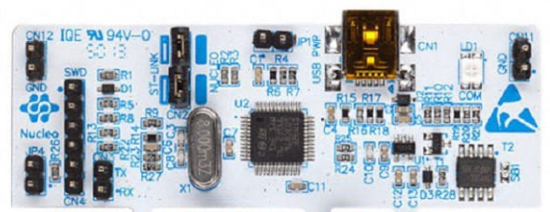
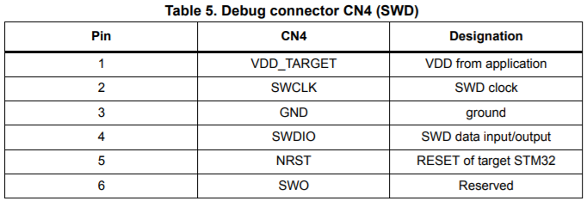
PB6 = A1
PB7 = A2
PB0 = B1
PB1 = B2
PA0 = C1
PA1 = C2
FT232RL USB to USART
+5V Power
GND
GND
CTS
VCC
SLCAN Adapter
uc4h-slcan-v007-pcb-v1x-f103t8c8cb.hex
TX
RX
DTR
<--
-->
PA11 (GRN) = CANRX
PA12 (YEL) = CANTX
PA9 (BRN) = UART1_TX -> RX USB-TTL
PA10 (GRY) = UART1_RX <- TX USB-TTL
CANH
CANL
CANRX
CANTX
GND
+3.3V Power
ARM SWD DEBUGGER
FreeRTOS Node
UAVCAN_NODE_FreeRTOS.hex

Slide 6
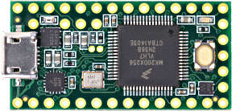
PB6 = A1
PB7 = A2
PB0 = B1
PB1 = B2
PA0 = C1
PA1 = C2
FT232RL USB to USART
+5V Power
GND
GND
CTS
VCC
TX
TX USB-TTL ->
RX
<- RX USB-TTL
DTR
CANH
CANL
CANRX
CANTX
Teensy 3.x CAN Adapter
uc4h-slcan-v007-pcb-v1x-f103t8c8cb.hex
GND
+3.3V Power
ESC/ACT Node
uc4h-bootloader-v002.hex
uc4h-escactuator-v014-node-v1x-f103t8c8cb-wobl.hex
PA11 (GRN) = CANRX
PA12 (YEL) = CANTX
PA9 (BRN) = UART1_TX -> RX USB-TTL
PA10 (GRY) = UART1_RX -> TX USB-TTL

Slide 7
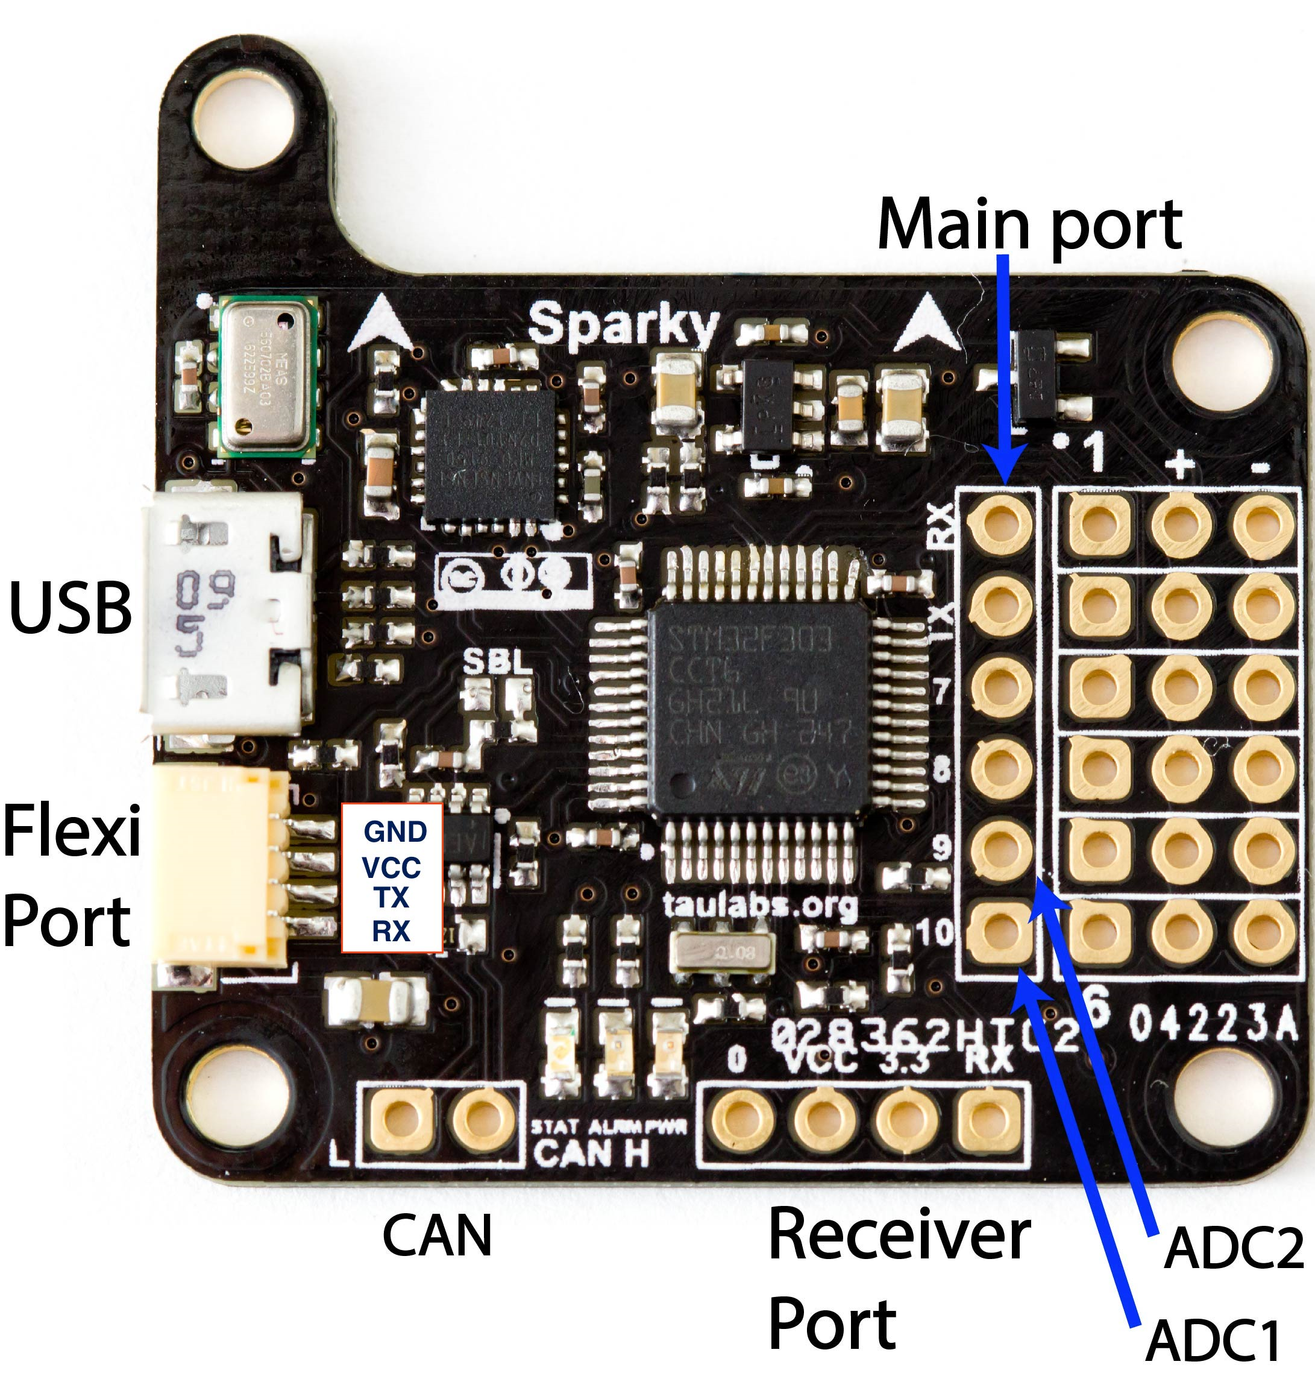
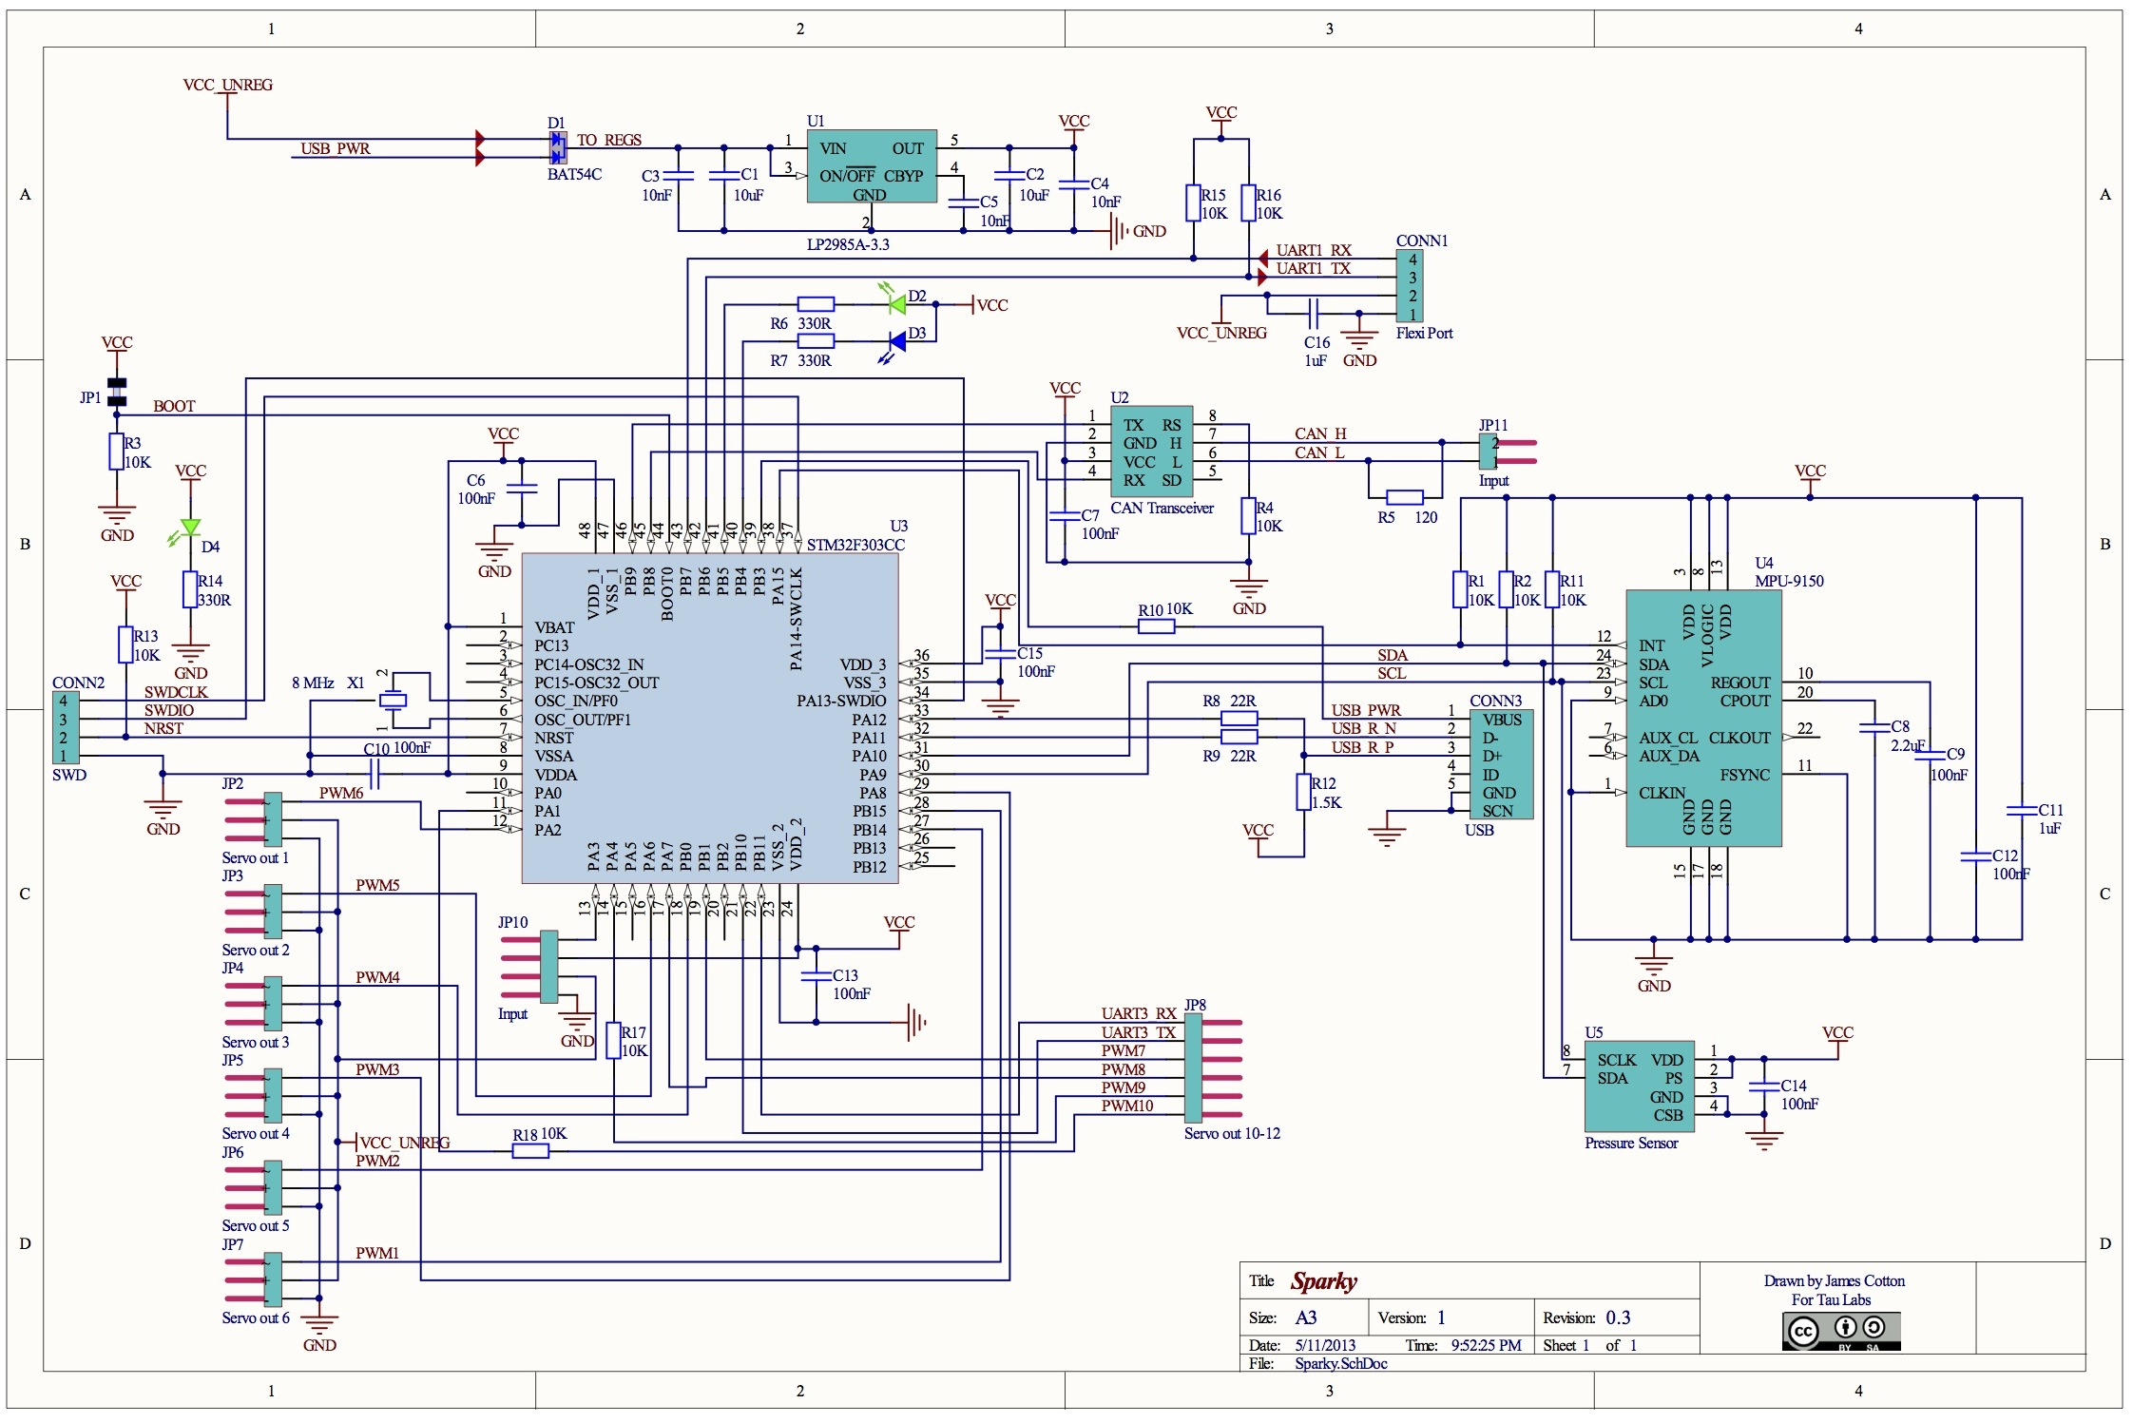
PB11 : D11
PB10 : D12
PB1 : D7
PA7 : D8
PA4 : D9
PA1 : D10
D1 : PB15
D2 : PB14
D3 : PA8
D4 : PB0
D5 : PA6
D6 : PA2
D13 BLU : PB4
D14 RED : PB5
Pwr GRN
LED
GND
VCC
D17 : PB6
D16 : PB7
CAN
LO HI
PA3
D15

Slide 8
BACKUP MATERIAL

Slide 9
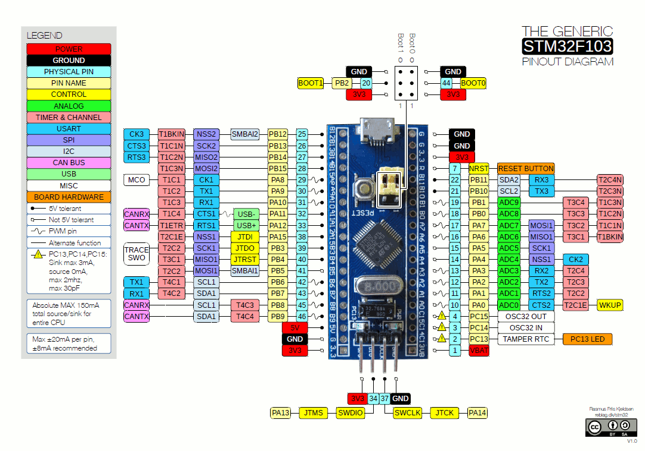

Slide 10
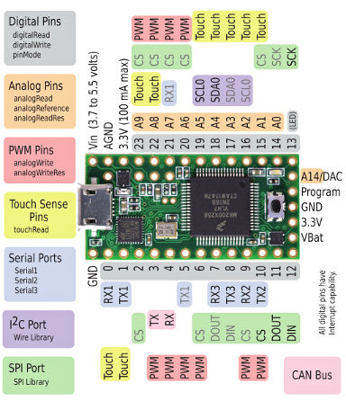
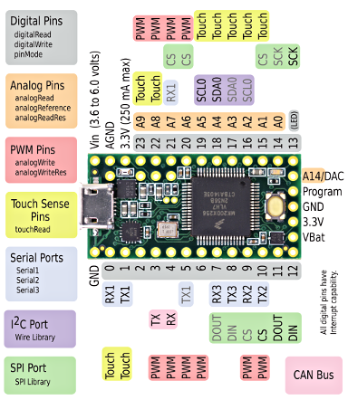

Slide 11
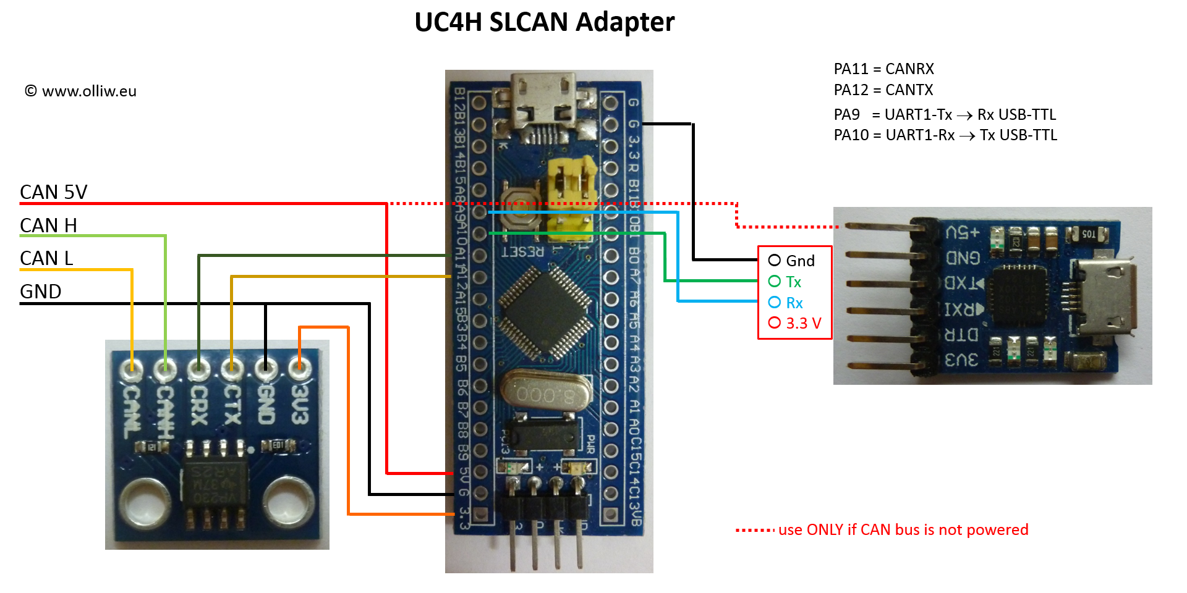

Slide 12
